Slide 1

BİP DEEP PACKET INSPECTION
BUĞRA BEDİR DURMUŞ

Slide 2
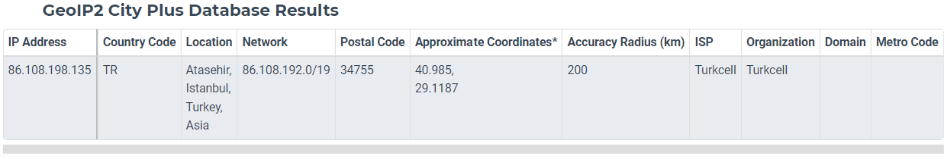
BRIEF INFORMATION
BİP is a freeware instant messaging application owned and developed by Turkcell. It allows users to send text messages, voice messages and video calling.
The app was launched in 2013 and it has 53 million active users.
The IP adress of the BİP server is shown above.

Slide 3
EXPERIMENTAL SETUP
Wireshark has been used for packet analysis of the application.
BİP web app was used as a hotspot to communicate with an Android mobile phone.
Unused applications were closed in order to prevent the requests.
The captured traffic saved in pcap files. 3 pcaps are analyzed.
-Chat
-Voice Call
-Video Call

Slide 4
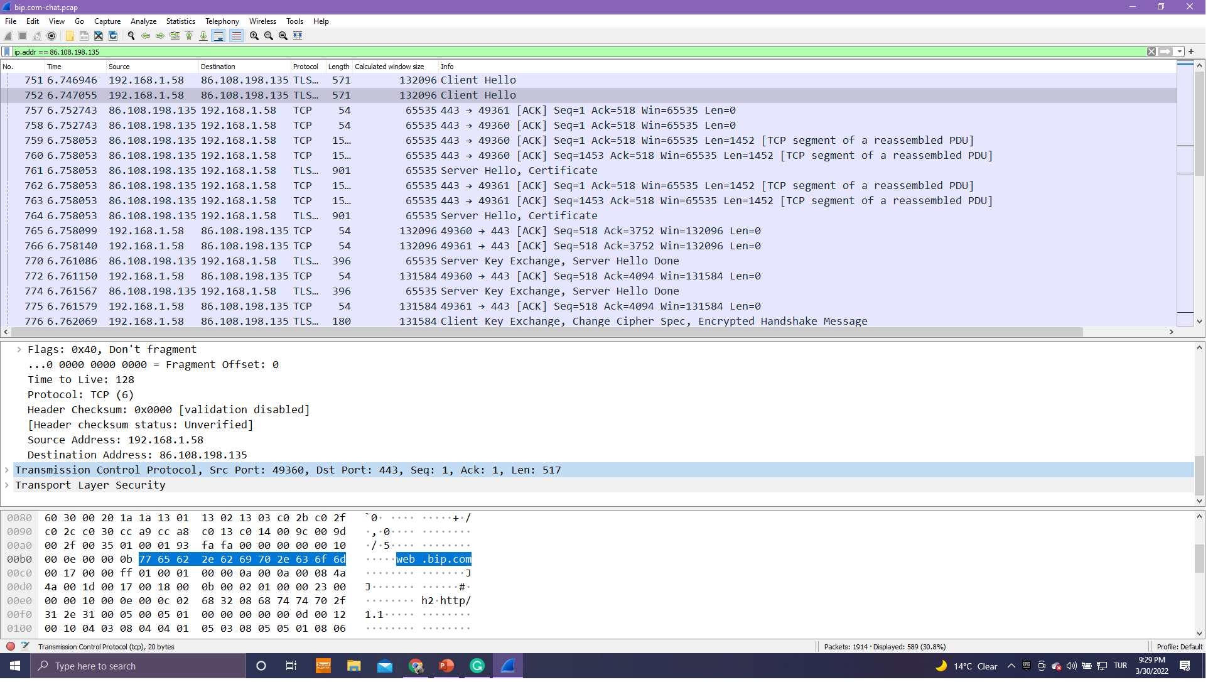
Packet Capture for Chat
As seen on the right side, 192.168.1.58 is the most seen IP adress during the capture. It is the IP adress of my Personal Computer.

Slide 5
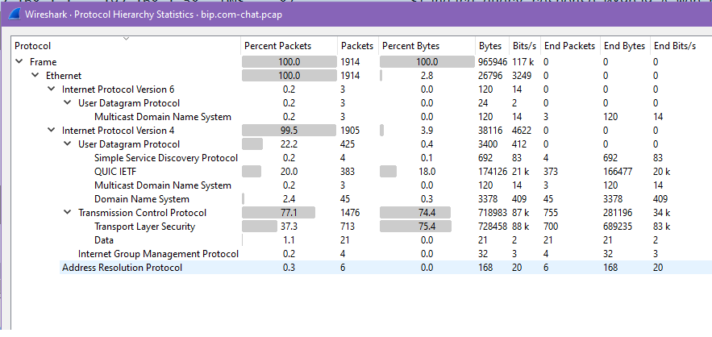
Protocol Hierarchy for Chat
This feature is mostly based on TCP.
QUIC protocol holds 20% of the existing ones.
QUIC(Quick UDP Internet Connection) is an experimental transport layer network protocol designed by Google.

Slide 6
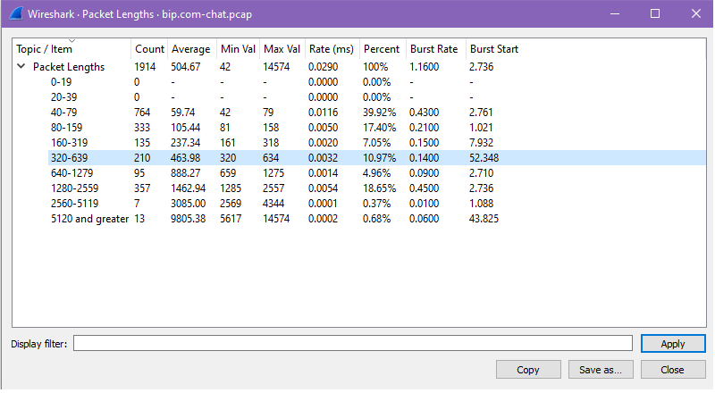
Packet Length for Chat
Total packet capture is few, compared to the voice call and cideo call.
The packet lengths were usually between 40-79

Slide 7
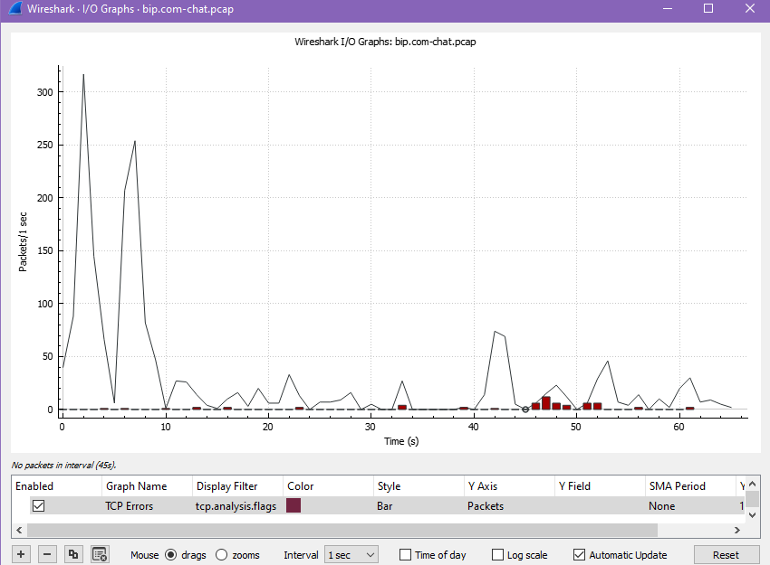
I/O Graph for Chat
Images

Slide 8
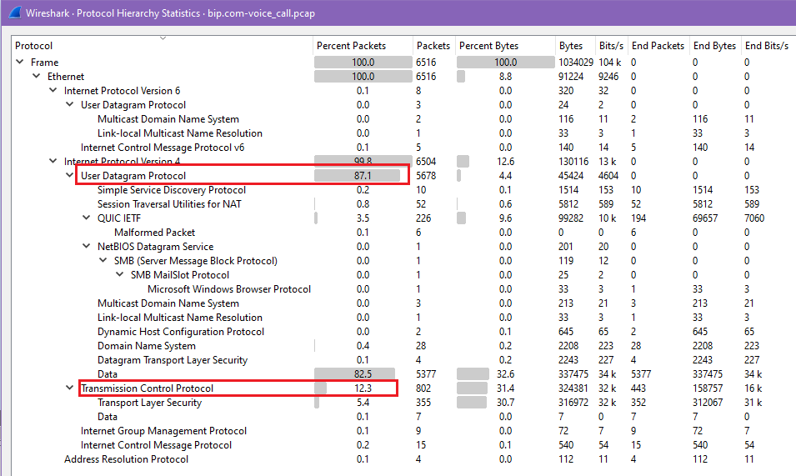
Protocol Hierarchy for Voice Call
UDP is dominant during the voice call.

Slide 9
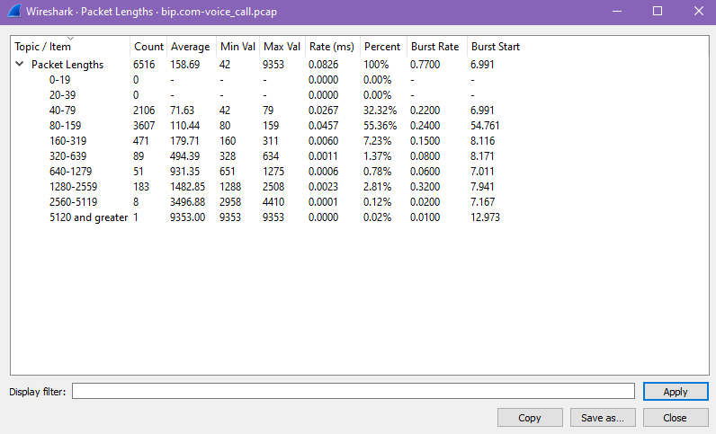
Packet Length For Voice Call
The packet lengths are larger in quantities

Slide 10
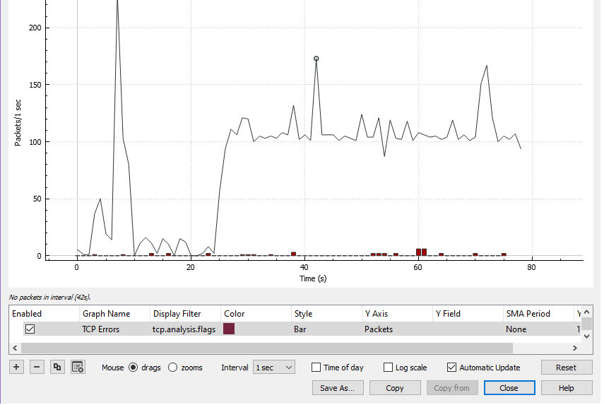
I/O Graph for Voice Call
The first big spike represents, me searhing for bip.com web app.
The conversation starts at 25s.

Slide 11
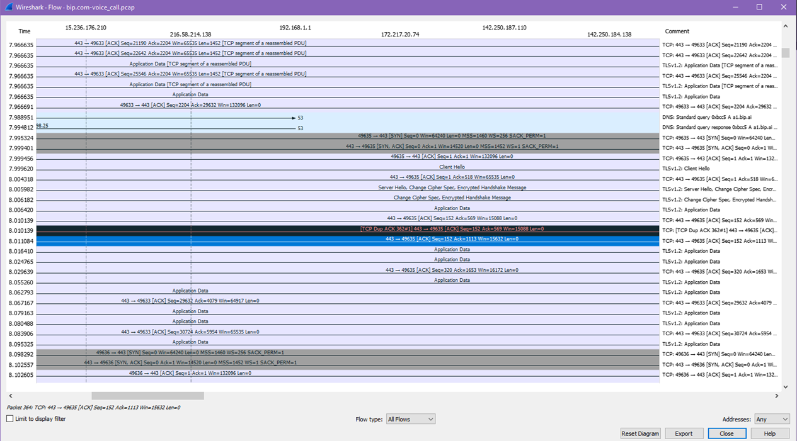
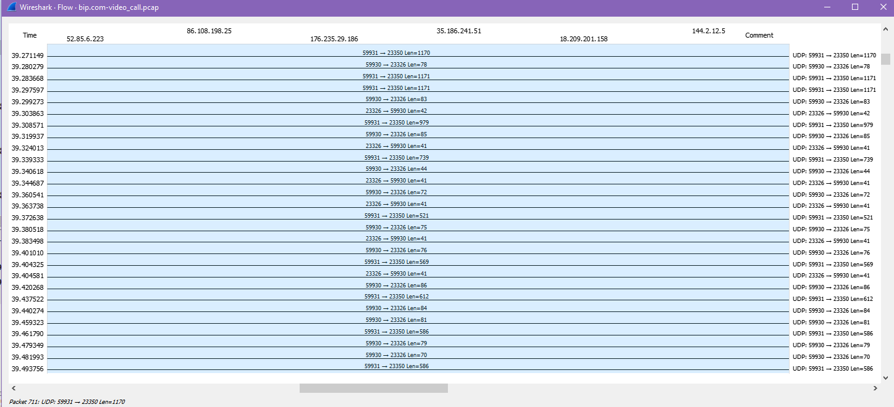
Flow Graph for Voice Call

Slide 12
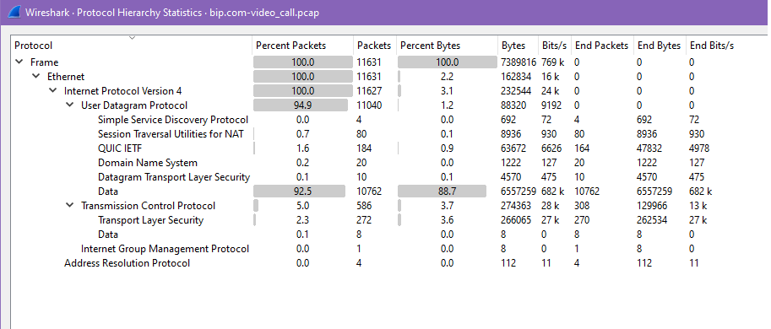
Protocol Hierarchy for Video Call

Slide 13
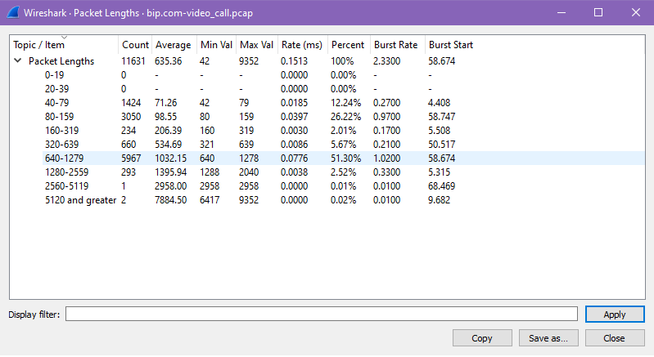
Packet Length for Video Call
The half of the packets were between lengths 640-1279

Slide 14
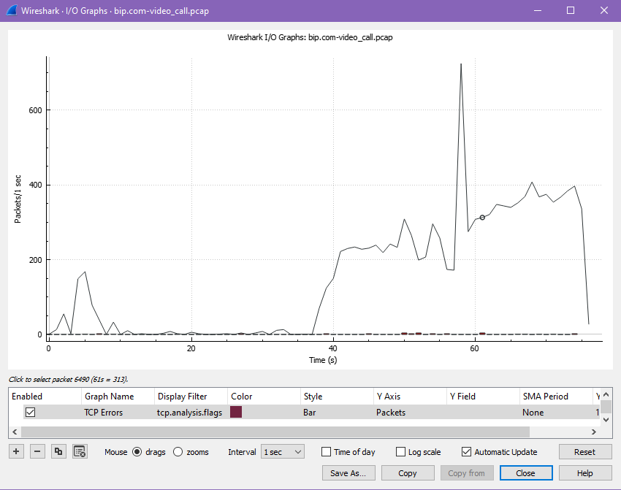
I/O Graph for Video Call
The call was halted intentionally to see the packet behavior.
The begining of the conversation can be seen at 37s.
After the call’s ending, packet exchange drops significantly.

Slide 15
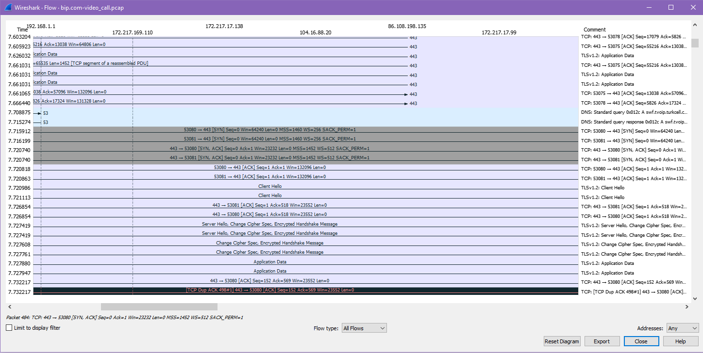
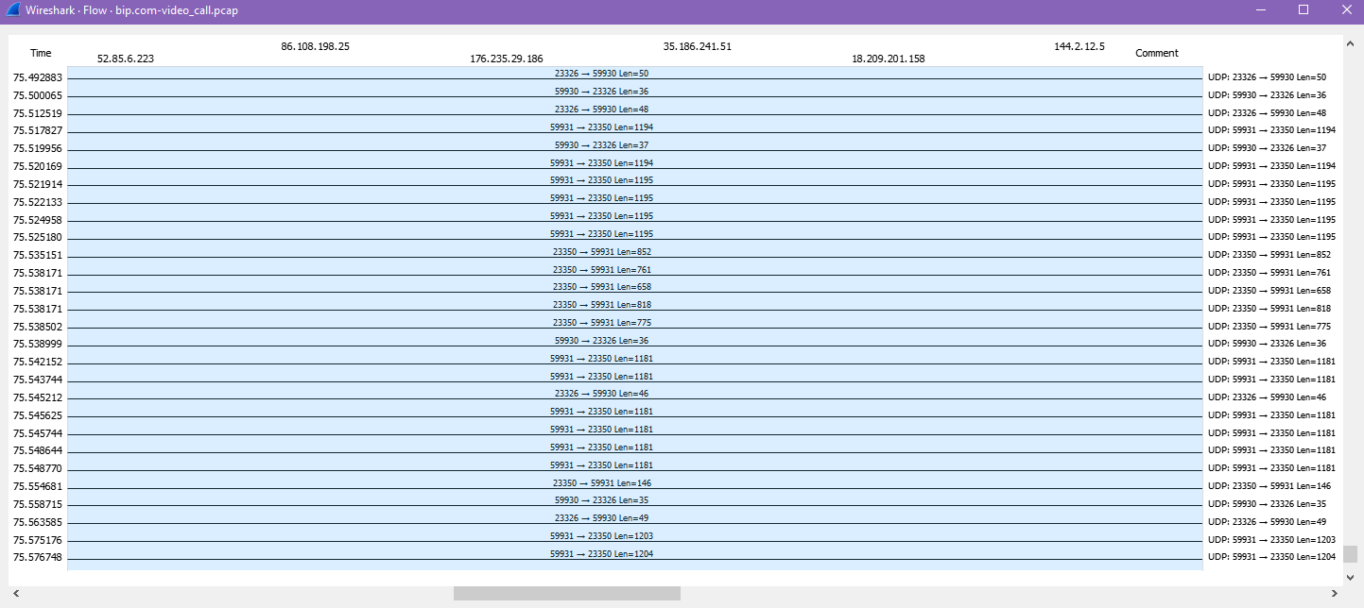
Flow Graph for Video Call

Slide 16


